Slide 1
Relational Algebra (Part-9)
20.8

Slide 2
Contents
Cartesian Product with condition

Slide 3
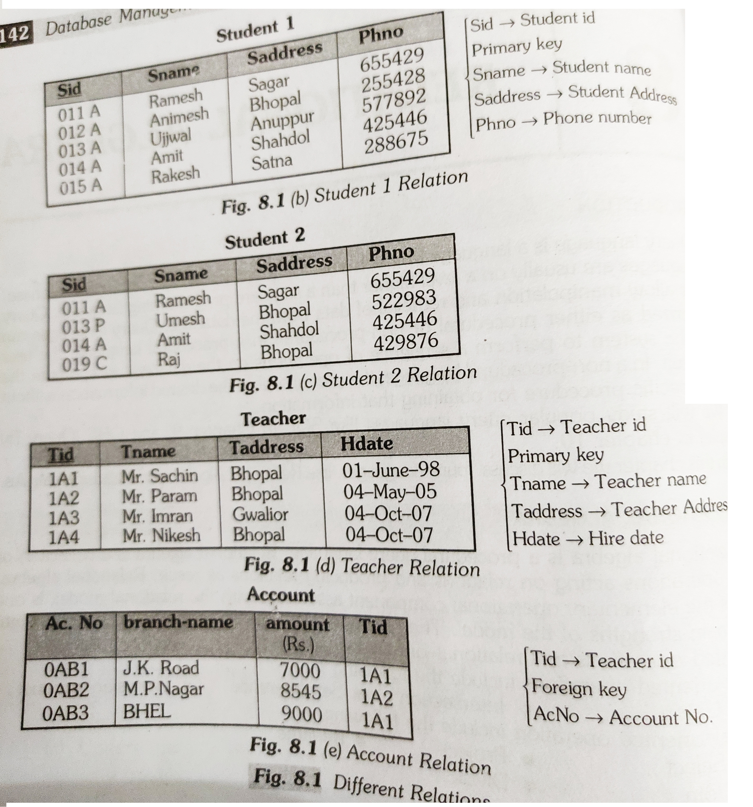
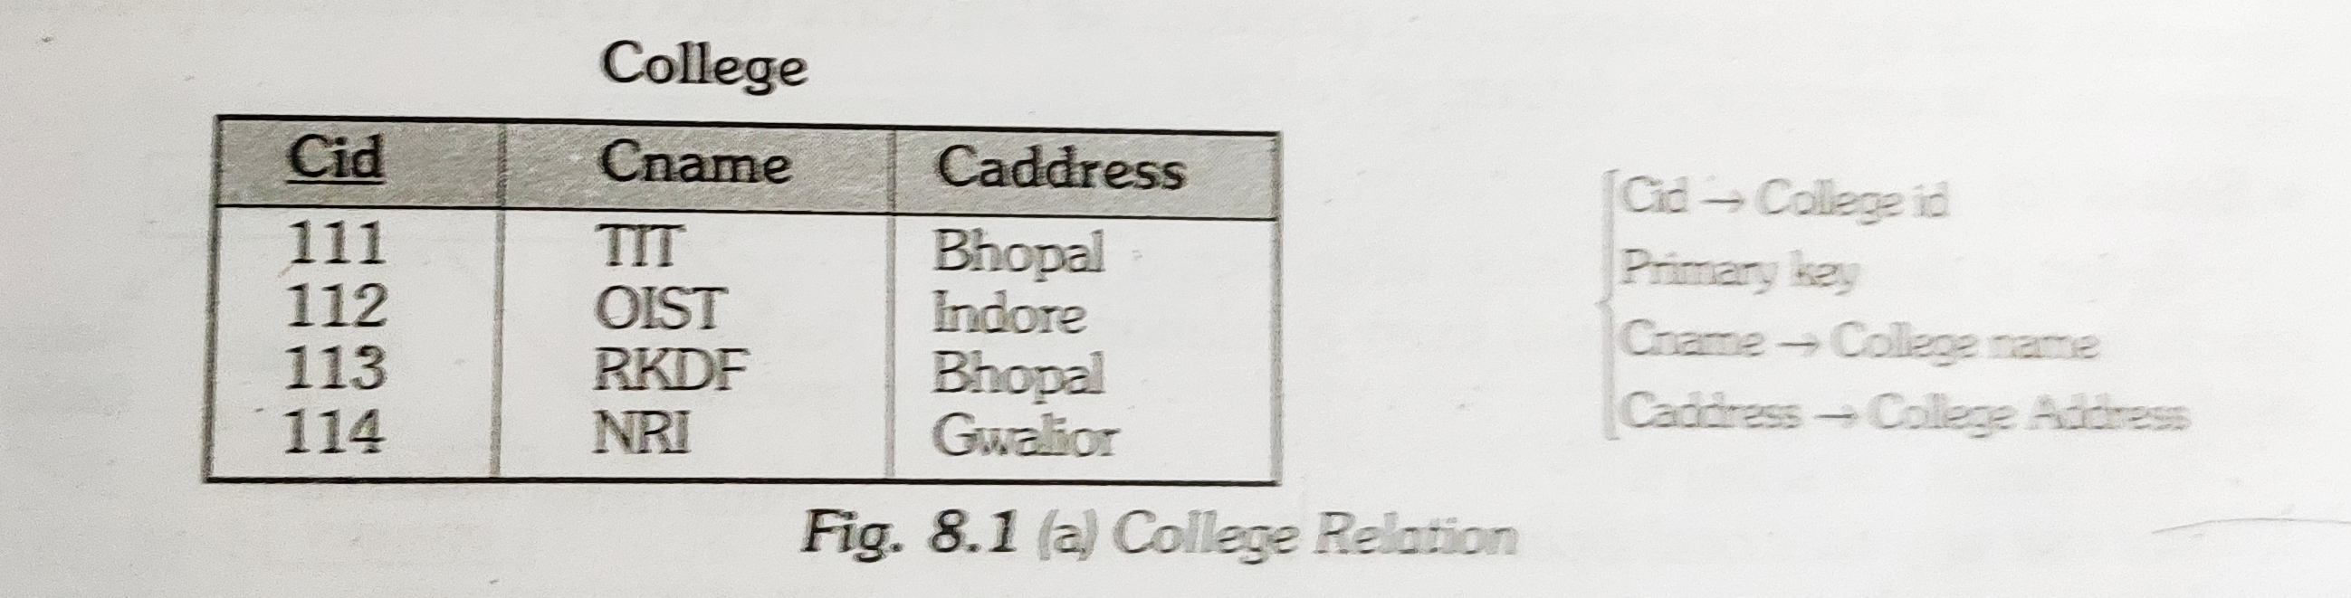
Cartesian Product

Slide 4
Cartesian Product with condition
The cartesian product operation applied by itself is generally meaningless. It is useful when it is applied by some selection criteria. There may be some condition where attributes of the two relation are same.
For example:
Student(SID, name, address)
Teacher(TID, name, address)

Slide 5
Cartesian product with condition
If we perform Student × Teacher then how can we distinguish the name attribute. There is a solution we attach the name of the relation with the attribute from which the attribute originally came.
(SID, Student-name, address, TID, Teacher-name, address)

Slide 6
Cartesian product with condition
If we perform Student × Teacher then how can we distinguish the name attribute. There is a solution we attach the name of the relation with the attribute from which the attribute originally came.
(SID, Student-name, address, TID, Teacher-name, address)

Slide 7
Cartesian product with condition
Find the teachers who have an account at the “BHEL” branch.

Slide 8


